Slide 1
Module 8: Network Layer
Introduction to Networks v7.0 (ITN)
Notes:
Cisco Networking Academy Program
Introduction to Networks v7.0 (ITN)
Module 8: Network Layer

Slide 2
8.1 Network Layer Characteristics
Notes:
8 – Network Layer
8.1 – Network Layer Characteristics

Slide 3
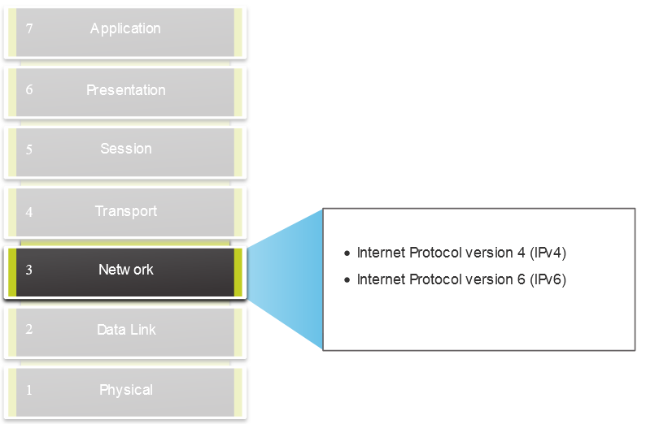
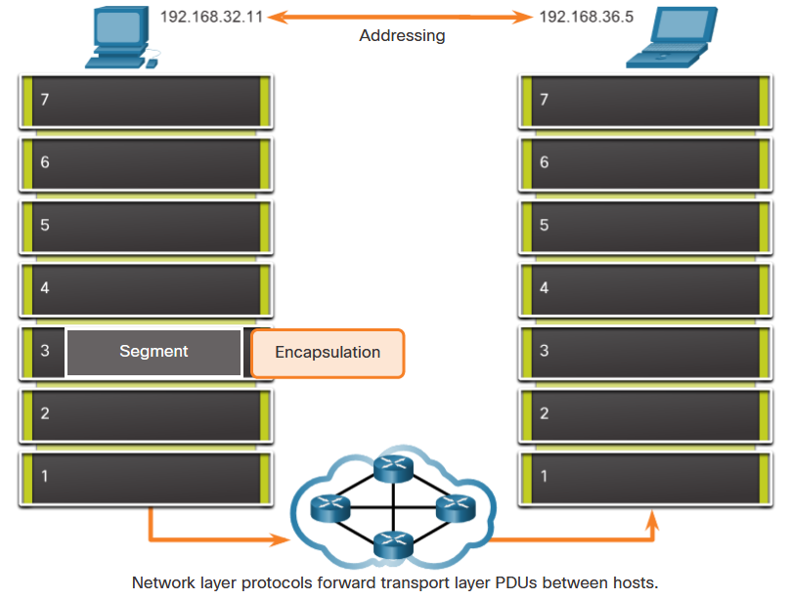
Network Layer Characteristics
The Network Layer
Provides services to allow end devices to exchange data
IP version 4 (IPv4) and IP version 6 (IPv6) are the principle network layer communication protocols.
The network layer performs four basic operations:
  Addressing end devices
  Encapsulation
  Routing
  De-encapsulation
Notes:
8 – Network Layer
8.1 – Network Layer Characteristics
8.1.1 – The Network Layer

Slide 4
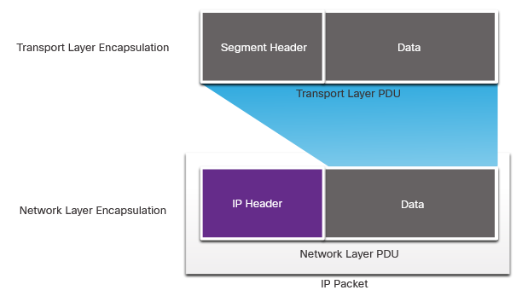
Network Layer Characteristics
IP Encapsulation
IP encapsulates the transport layer segment.
IP can use either an IPv4 or IPv6 packet and not impact the layer 4 segment.
IP packet will be examined by all layer 3 devices as it traverses the network.
The IP addressing does not change from source to destination.
Note: NAT will change addressing, but will be discussed in a later module.
Notes:
8 – Network Layer
8.1 – Network Layer Characteristics
8.1.2 – IP Encapsulation

Slide 5
Network Layer Characteristics
Characteristics of IP
IP is meant to have low overhead and may be described as:
  Connectionless
  Best Effort
  Media Independent
Notes:
8 – Network Layer
8.1 – Network Layer Characteristics
8.1.3 – Characteristics of IP

Slide 6
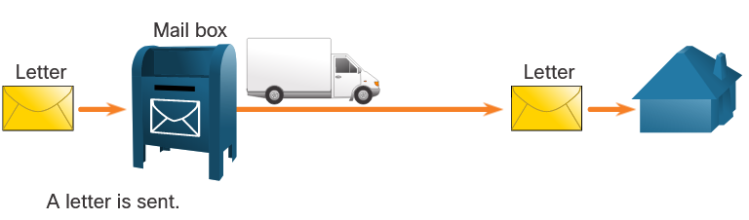
Network Layer Characteristics
Connectionless
IP is Connectionless
IP does not establish a connection with the destination before sending the packet.
There is no control information needed (synchronizations, acknowledgments, etc.).
The destination will receive the packet when it arrives, but no pre-notifications are sent by IP.
If there is a need for connection-oriented traffic, then another protocol will handle this (typically TCP at the transport layer).
Notes:
8 – Network Layer
8.1 – Network Layer Characteristics
8.1.4 – Connectionless

Slide 7
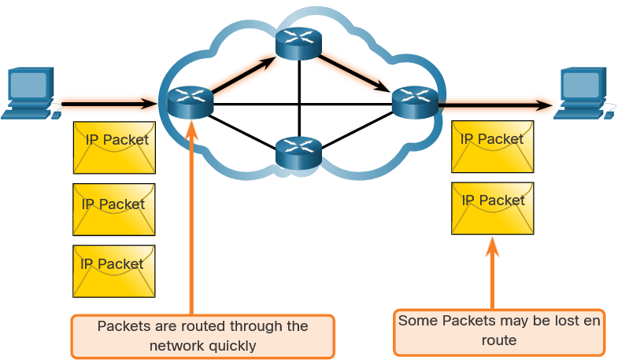
Network Layer Characteristics
Best Effort
IP is Best Effort
IP will not guarantee delivery of the packet.
IP has reduced overhead since there is no mechanism to resend data that is not received.
IP does not expect acknowledgments.
IP does not know if the other device is operational or if it received the packet.
Notes:
8 – Network Layer
8.1 – Network Layer Characteristics
8.1.5 – Best Effort

Slide 8
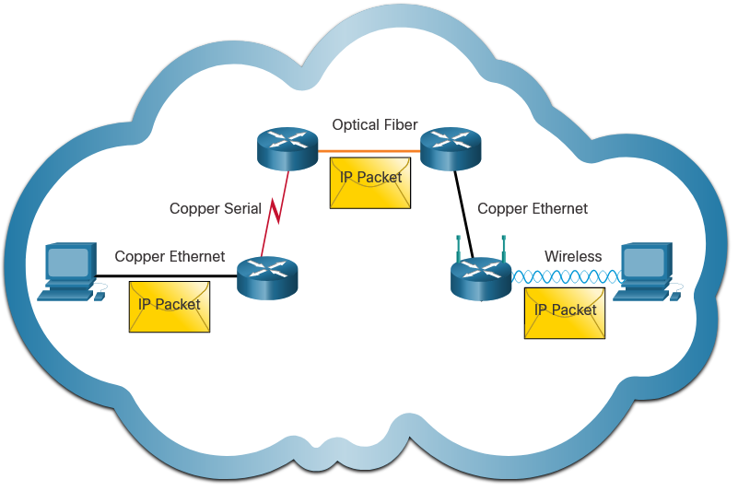
Network Layer Characteristics
Media Independent
IP is unreliable:
  It cannot manage or fix undelivered or corrupt packets.
  IP cannot retransmit after an error.
  IP cannot realign out of sequence packets.
  IP must rely on other protocols for these functions.
IP is media Independent:
  IP does not concern itself with the type of frame required at the data link layer or the media type at the physical layer.
  IP can be sent over any media type: copper, fiber, or wireless.
Notes:
8 – Network Layer
8.1 – Network Layer Characteristics
8.1.6 – Media Independent
8.1.7 Check Your Understanding – IP Characteristics

Slide 9
Network Layer Characteristics
Media Independent (Contd.)
The network layer will establish the Maximum Transmission Unit (MTU).
  Network layer receives this from control information sent by the data link layer.
  The network then establishes the MTU size.
Fragmentation is when Layer 3 splits the IPv4 packet into smaller units.
  Fragmenting causes latency.
  IPv6 does not fragment packets.
  Example: Router goes from Ethernet to a slow WAN with a smaller MTU
Notes:
8 – Network Layer
8.1 – Network Layer Characteristics
8.1.6 – Media Independent
8.1.7 Check Your Understanding – IP Characteristics

Slide 10
8.2 IPv4 Packet
Notes:
8 – Network Layer
8.2 – IPv4 Packet

Slide 11
IPv4 Packet
IPv4 Packet Header
IPv4 is the primary communication protocol for the network layer.
The network header has many purposes:
  It ensures the packet is sent in the correct direction (to the destination).
  It contains information for network layer processing in various fields.
  The information in the header is used by all layer 3 devices that handle the packet
Notes:
8 – Network Layer
8.2 – IPv4 Packet
8.2.1 – IPv4 Packet Header

Slide 12
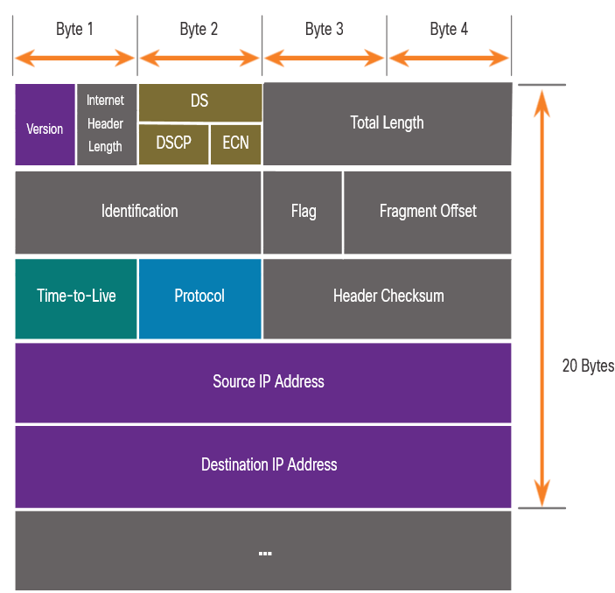
IPv4 Packet
IPv4 Packet Header Fields
The IPv4 network header characteristics:
  It is in binary.
  Contains several fields of information
  Diagram is read from left to right, 4 bytes per line
  The two most important fields are the source and destination.
Protocols may have one or more functions.
Notes:
8 – Network Layer
8.2 – IPv4 Packet
8.2.2 – IPv4 Packet Header Fields

Slide 13
IPv4 Packet
IPv4 Packet Header Fields
Significant fields in the IPv4 header:
Function | Description
Version | This will be for v4, as opposed to v6, a 4 bit field= 0100
Differentiated Services | Used for QoS: DiffServ – DS field or the older IntServ – ToS or Type of Service
Header Checksum | Detect corruption in the IPv4 header
Time to Live (TTL) | Layer 3 hop count. When it becomes zero the router will discard the packet.
Protocol | I.D.s next level protocol: ICMP, TCP, UDP, etc.
Source IPv4 Address | 32 bit source address
Destination IPV4 Address | 32 bit destination address
Notes:
8 – Network Layer
8.2 – IPv4 Packet
8.2.2 – IPv4 Packet Header Fields

Slide 14
8.3 IPv6 Packets
Notes:
8 – Network Layer
8.3 – IPv6 Packets

Slide 15
IPv6 Packets
Limitations of IPv4
IPv4 has three major limitations:
  IPv4 address depletion – We have basically run out of IPv4 addressing.
  Lack of end-to-end connectivity – To make IPv4 survive this long, private addressing and NAT were created. This ended direct communications with public addressing.
  Increased network complexity – NAT was meant as temporary solution and creates issues on the network as a side effect of manipulating the network headers addressing. NAT causes latency and troubleshooting issues.
Notes:
8 – Network Layer
8.3 – IPv6 Packets
8.3.1 – Limitations of IPv4

Slide 16
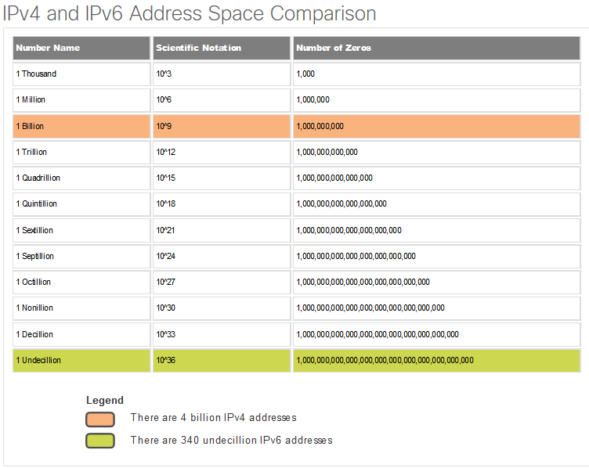
IPv6 Packets
IPv6 Overview
IPv6 was developed by Internet Engineering Task Force (IETF).
IPv6 overcomes the limitations of IPv4.
Improvements that IPv6 provides:
  Increased address space – based on 128 bit address, not 32 bits
  Improved packet handling – simplified header with fewer fields
  Eliminates the need for NAT – since there is a huge amount of addressing, there is no need to use private addressing internally and be mapped to a shared public address
Notes:
8 – Network Layer
8.3 – IPv6 Packets
8.3.2 – IPv6 Overview

Slide 17
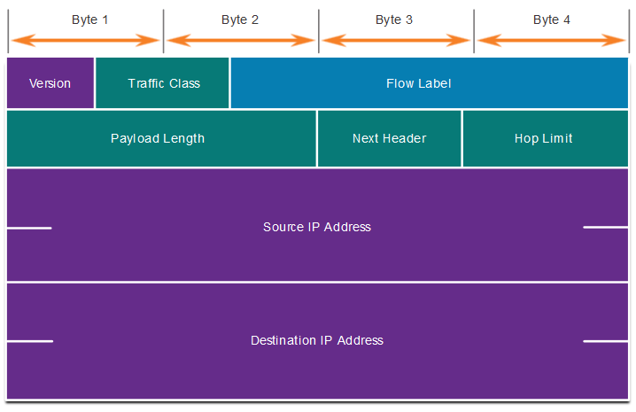
IPv6 Packets
IPv4 Packet Header Fields in the IPv6 Packet Header
The IPv6 header is simplified, but not smaller.
The header is fixed at 40 Bytes or octets long.
Several IPv4 fields were removed to improve performance.
Some IPv4 fields were removed to improve performance:
  Flag
  Fragment Offset
  Header Checksum
Notes:
8 – Network Layer
8.3 – IPv6 Packets
8.3.3 – IPv4 Packet Header Fields in the IPv6 Packet Header

Slide 18
IPv6 Packets
IPv6 Packet Header
Significant fields in the IPv6 header:
Function | Description
Version | This will be for v6, as opposed to v4, a 4 bit field= 0110
Traffic Class | Used for QoS: Equivalent to DiffServ – DS field
Flow Label | Informs device to handle identical flow labels the same way, 20 bit field
Payload Length | This 16-bit field indicates the length of the data portion or payload of the IPv6 packet
Next Header | I.D.s next level protocol: ICMP, TCP, UDP, etc.
Hop Limit | Replaces TTL field Layer 3 hop count
Source IPv6 Address | 128 bit source address
Destination IPv6 Address | 128 bit destination address
Notes:
8 – Network Layer
8.3 – IPv6 Packets
8.3.4 – IPv6 Packet Header

Slide 19
IPv6 Packets
IPv6 Packet Header (Cont.)
IPv6 packet may also contain extension headers (EH).
EH headers characteristics:
provide optional network layer information
are optional
are placed between IPv6 header and the payload
may be used for fragmentation, security, mobility support, etc.
Note: Unlike IPv4, routers do not fragment IPv6 packets.
Notes:
8 – Network Layer
8.3 – IPv6 Packets
8.3.4 – IPv6 Packet Header (Cont.)

Slide 20
8.4 How a Host Routes
Notes:
8 – Network Layer
8.4 – How a Host Routes

Slide 21
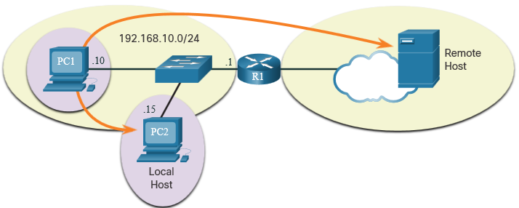
How a Host Routes
Host Forwarding Decision
Packets are always created at the source.
Each host devices creates their own routing table.
A host can send packets to the following:
  Itself – 127.0.0.1 (IPv4), ::1 (IPv6)
  Local Hosts – destination is on the same LAN
  Remote Hosts – devices are not on the same LAN
Notes:
8 – Network Layer
8.4 – How a Host Routes
8.4.1 – Host Forwarding Decision

Slide 22
How a Host Routes
Host Forwarding Decision (Cont.)
The Source device determines whether the destination is local or remote
Method of determination:
  IPv4 – Source uses its own IP address and Subnet mask, along with the destination IP address
  IPv6 – Source uses the network address and prefix advertised by the local router
Local traffic is dumped out the host interface to be handled by an intermediary device.
Remote traffic is forwarded directly to the default gateway on the LAN.
Notes:
8 – Network Layer
8.4 – How a Host Routes
8.4.1 – Host Forwarding Decision (Cont.)

Slide 23
How a Host Routes
Default Gateway
A router or layer 3 switch can be a default-gateway.
Features of a default gateway (DGW):
  It must have an IP address in the same range as the rest of the LAN.
  It can accept data from the LAN and is capable of forwarding traffic off of the LAN.
  It can route to other networks.
If a device has no default gateway or a bad default gateway, its traffic will not be able to leave the LAN.
Notes:
8 – Network Layer
8.4 – How a Host Routes
8.4.2 – Default Gateway

Slide 24
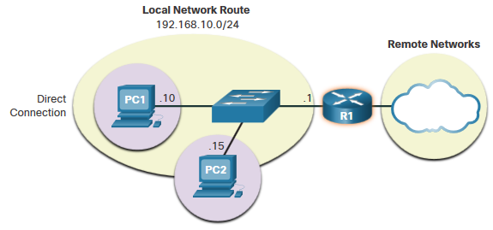
How a Host Routes
A Host Routes to the Default Gateway
The host will know the default gateway (DGW) either statically or through DHCP in IPv4.
IPv6 sends the DGW through a router solicitation (RS) or can be configured manually.
A DGW is static route which will be a last resort route in the routing table.
All device on the LAN will need the DGW of the router if they intend to send traffic remotely.
Notes:
8 – Network Layer
8.4 – How a Host Routes
8.4.3 – A Host Routes to the Default Gateway

Slide 25
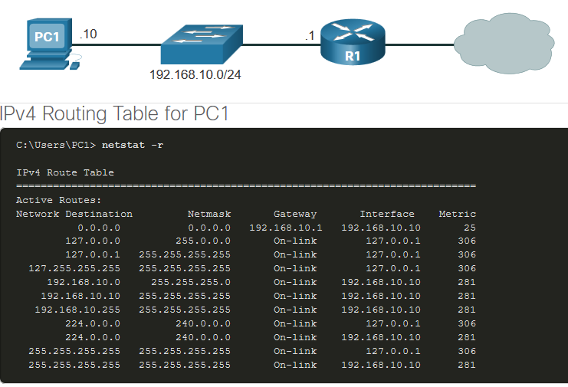
How a Host Routes
Host Routing Tables
On Windows, route print or netstat -r to display the PC routing table
Three sections displayed by these two commands:
  Interface List – all potential interfaces and MAC addressing
  IPv4 Routing Table
  IPv6 Routing Table
Notes:
8 – Network Layer
8.4 – How a Host Routes
8.4.4 – Host Routing Tables
8.4.5 – Check Your Understanding – How a Host Routes

Slide 26
8.5 Introduction to Routing
Notes:
8 – Network Layer
8.5 – Introduction to Routing

Slide 27
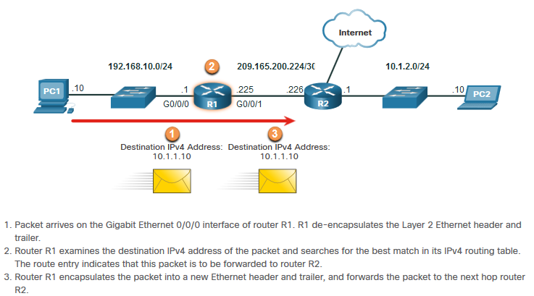
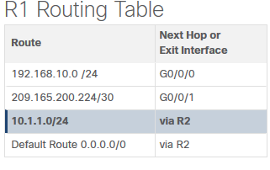
Introduction to Routing
Router Packet Forwarding Decision
What happens when the router receives the frame from the host device?
10.1.1.0/24
Notes:
8 – Network Layer
8.5 – Introduction to Routing
8.5.1 – Router Packet Forwarding Decision

Slide 28
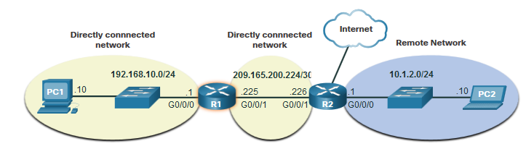
Introduction to Routing
IP Router Routing Table
There three types of routes in a router’s routing table:
Directly Connected – These routes are automatically added by the router, provided the interface is active and has addressing.
Remote – These are the routes the router does not have a direct connection and may be learned:
  Manually – with a static route
  Dynamically – by using a routing protocol to have the routers share their information with each other
Default Route – this forwards all traffic to a specific direction when there is not a match in the routing table
Notes:
8 – Network Layer
8.5 – Introduction to Routing
8.5.2 – IP Router Routing Table

Slide 29
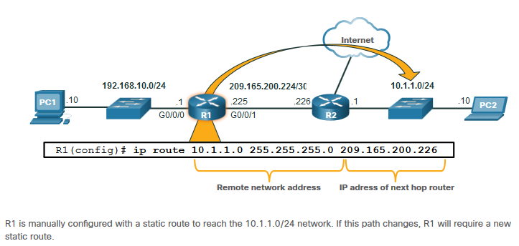
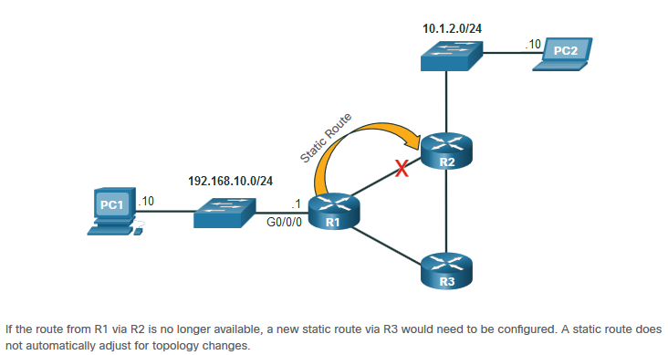
Introduction to Routing
Static Routing
Static Route Characteristics:
Must be configured manually
Must be adjusted manually by the administrator when there is a change in the topology
Good for small non-redundant networks
Often used in conjunction with a dynamic routing protocol for configuring a default route
R2(config)# ip route 192.168.10.0 255.255.255.0 209.165.200.225
Notes:
8 – Network Layer
8.5 – Introduction to Routing
8.5.3 – Static Routing

Slide 30
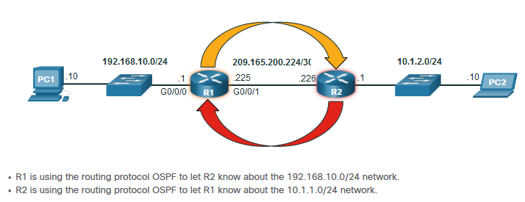
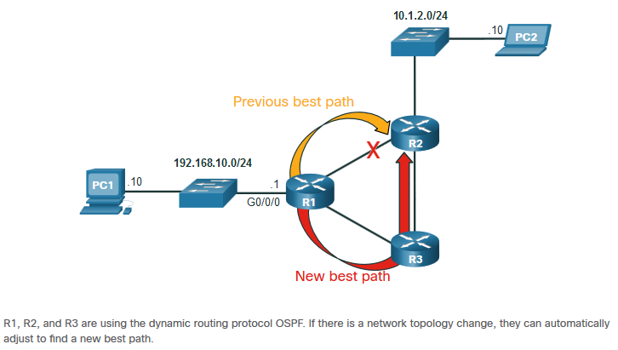
Introduction to Routing
Dynamic Routing
Dynamic Routes Automatically:
Discover remote networks
Maintain up-to-date information
Choose the best path to the destination
Find new best paths when there is a topology change
Dynamic routing can also share static default routes with the other routers.
Notes:
8 – Network Layer
8.5 – Introduction to Routing
8.5.4 – Dynamic Routing

Slide 31
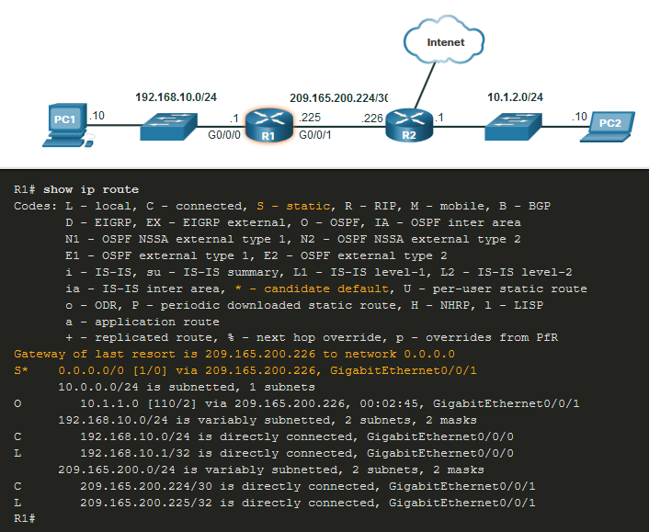
Introduction to Routing
Introduction to an IPv4 Routing Table
The show ip route command shows the following route sources:
  L - Directly connected local interface IP address
  C – Directly connected network
  S – Static route was manually configured by an administrator
  O – OSPF
  D – EIGRP
This command shows types of routes:
  Directly Connected – C and L
  Remote Routes – O, D, etc.
  Default Routes – S*
10.1.1.0/24
Notes:
8 – Network Layer
8.5 – Introduction to Routing
8.5.6 – Introduction to an IPv4 Routing Table
8.5.7 – Check Your Understanding – Introduction to Routing

Slide 32
Module 9: Address Resolution
Introduction to Networks v7.0 (ITN)
Notes:
Cisco Networking Academy Program
Introduction to Networks v7.0 (ITN)
Module 9: Address Resolution

Slide 33
9.1 MAC and IP
Notes:
9 - Address Resolution
9.1 MAC and IP

Slide 34
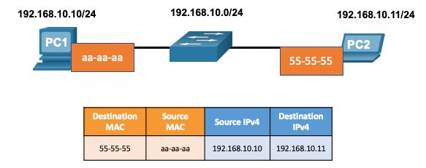
MAC and IP
Destination on Same Network
There are two primary addresses assigned to a device on an Ethernet LAN:
  Layer 2 physical address (the MAC address) – Used for NIC to NIC communications on the same Ethernet network.
  Layer 3 logical address (the IP address) – Used to send the packet from the source device to the destination device.
  Layer 2 addresses are used to deliver frames from one NIC to another NIC on the same network. If a destination IP address is on the same network, the destination MAC address will be that of the destination device.
Notes:
9 – Address Resolution
9.1 – MAC and IP
9.1.1 – Destination on Same Network

Slide 35
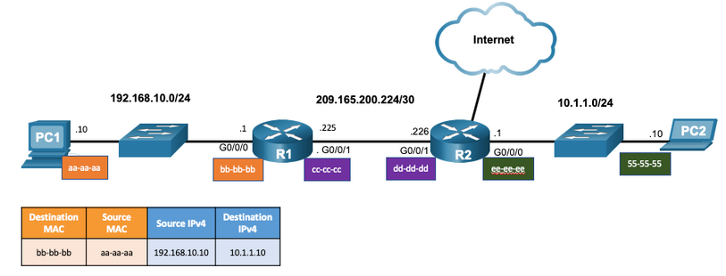
MAC and IP
Destination on Remote Network
When the destination IP address is on a remote network, the destination MAC address is that of the default gateway.
  ARP is used by IPv4 to associate the IPv4 address of a device with the MAC address of the device NIC.
  ICMPv6 is used by IPv6 to associate the IPv6 address of a device with the MAC address of the device NIC.
Notes:
9 – Address Resolution
9.1 – MAC and IP
9.1.2 – Destination on Remote Network

Slide 36
9.2 ARP
Notes:
9 - Address Resolution
9.2 ARP

Slide 37
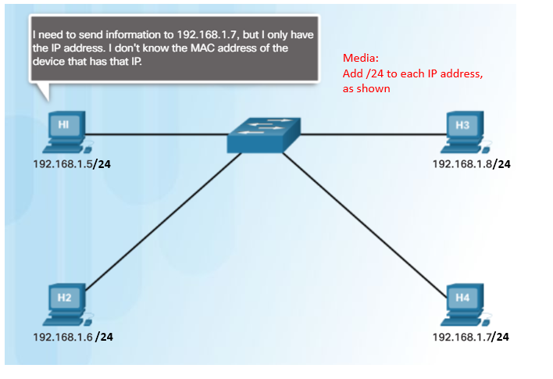
ARP
ARP Overview
A device uses ARP to determine the destination MAC address of a local device when it knows its IPv4 address.
ARP provides two basic functions:
  Resolving IPv4 addresses to MAC addresses
  Maintaining an ARP table of IPv4 to MAC address mappings
Notes:
9 – Address Resolution
9.2 – ARP
9.2.1 – ARP Overview

Slide 38
ARP
ARP Functions
To send a frame, a device will search its ARP table for a destination IPv4 address and a corresponding MAC address.
  If the packet’s destination IPv4 address is on the same network, the device will search the ARP table for the destination IPv4 address.
  If the destination IPv4 address is on a different network, the device will search the ARP table for the IPv4 address of the default gateway.
  If the device locates the IPv4 address, its corresponding MAC address is used as the destination MAC address in the frame.
  If there is no ARP table entry is found, then the device sends an ARP request.
Notes:
9 – Address Resolution
9.2 – ARP
9.2.2 – ARP Functions

Slide 39
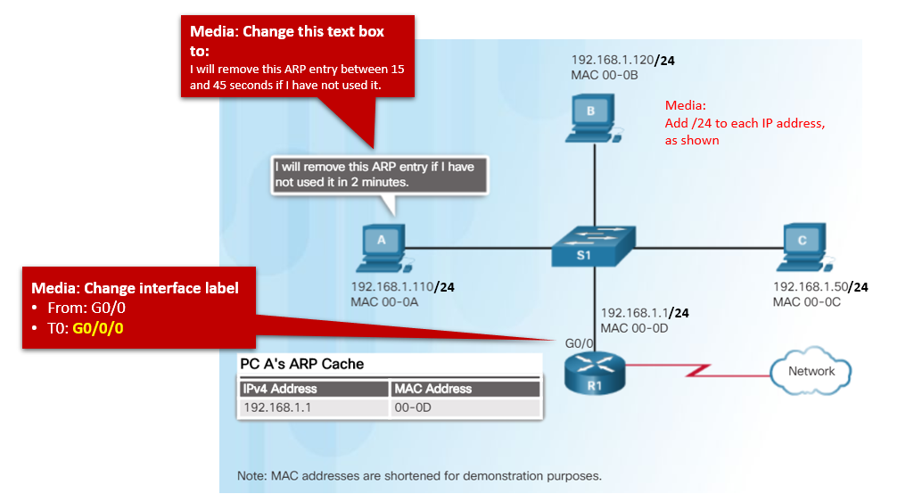
ARP
Removing Entries from an ARP Table
Entries in the ARP table are not permanent and are removed when an ARP cache timer expires after a specified period of time.
The duration of the ARP cache timer differs depending on the operating system.
ARP table entries can also be removed manually by the administrator.
Notes:
9 – Address Resolution
9.2 – ARP
9.2.6– Removing Entries from an ARP Table

Slide 40
ARP
ARP Tables on Networking Devices
The show ip arp command displays the ARP table on a Cisco router.
The arp –a command displays the ARP table on a Windows 10 PC.
R1# show ip arp
Protocol Address Age (min) Hardware Addr Type Interface
Internet 192.168.10.1 - a0e0.af0d.e140 ARPA GigabitEthernet0/0/0
C:\Users\PC> arp -a
Interface: 192.168.1.124 --- 0x10
Internet Address Physical Address Type
192.168.1.1 c8-d7-19-cc-a0-86 dynamic
192.168.1.101 08-3e-0c-f5-f7-77 dynamic
Notes:
9 – Address Resolution
9.2 – ARP
9.2.7 – ARP Tables on Networking Devices

Slide 41
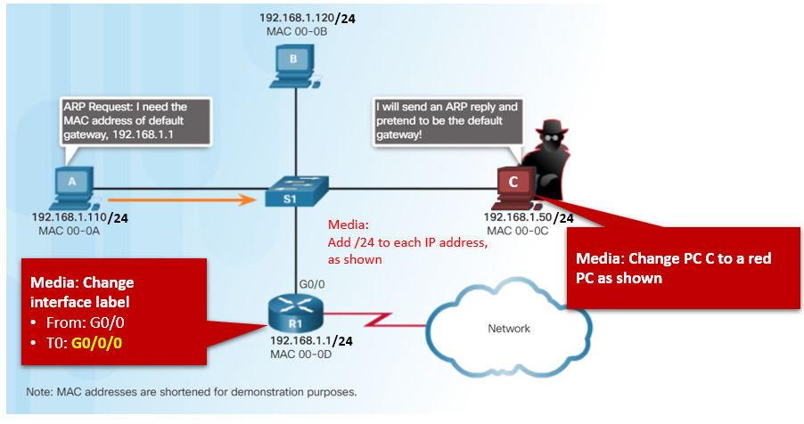
ARP
ARP Issues – ARP Broadcasting and ARP Spoofing
ARP requests are received and processed by every device on the local network.
Excessive ARP broadcasts can cause some reduction in performance.
ARP replies can be spoofed by a threat actor to perform an ARP poisoning attack.
Enterprise level switches include mitigation techniques to protect against ARP attacks.
Notes:
9 – Address Resolution
9.2 – ARP
9.2.8 – ARP Issues – ARP Broadcast and ARP Spoofing

Slide 42
IPv6 Neighbor Discovery
IPv6 Neighbor Discovery Messages
IPv6 Neighbor Discovery (ND) protocol provides:
  Address resolution
  Router discovery
  Redirection services
ICMPv6 Neighbor Solicitation (NS) and Neighbor Advertisement (NA) messages are used for device-to-device messaging such as address resolution.
ICMTPv6 Router Solicitation (RS) and Router Advertisement (RA) messages are used for messaging between devices and routers for router discovery.
ICMPv6 redirect messages are used by routers for better next-hop selection.
Notes:
9 – Address Resolution
9.3 – IPv6 Neighbor Discovery
9.3.2 – IPv6 Neighbor Discovery Messages

Slide 43
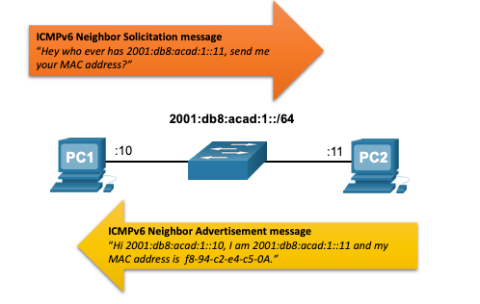
IPv6 Neighbor Discovery
IPv6 Neighbor Discovery – Address Resolution
IPv6 devices use ND to resolve the MAC address of a known IPv6 address.
ICMPv6 Neighbor Solicitation messages are sent using special Ethernet and IPv6 multicast addresses.
A Solicited-Node address is created by taking the least-significant 24 bits of a unicast or anycast address and appending them to the prefix ff02::1:ff00:0/104.^{[1]}
For example ff02::1:ff28:9c5a
Notes:
9 – Address Resolution
9.3 – IPv6 Neighbor Discovery
9.3.3 – IPv6 Neighbor Discovery – Address Resolution

Slide 44
Module 10: Basic Router Configuration
Introduction to Networks v7.0 (ITN)
Notes:
Cisco Networking Academy Program
Introduction to Networks v7.0 (ITN)
Module 10: Basic Router Configuration

Slide 45
10.1 Configure Initial Router Settings
Notes:
10 – Basic Router Configuration
10.1 Configure Initial Router Settings

Slide 46

Configure Initial Router Settings
Basic Router Configuration Steps
Configure the device name.
Secure privileged EXEC mode.
Secure user EXEC mode.
Secure remote Telnet / SSH access.
Encrypt all plaintext passwords.
Provide legal notification and save the configuration.
Router(config)# hostname hostname
Router(config)# enable secret password
Router(config)# line console 0
Router(config-line)# password password
Router(config-line)# login
Router(config)# line vty 0 4
Router(config-line)# password password
Router(config-line)# login
Router(config-line)# transport input {ssh | telnet}
Router(config)# service password encryption
Router(config)# banner motd # message #
Router(config)# end
Router# copy running-config startup-config
Router>enable
Router#configure terminal
Notes:
10 – Basic Router Configuration
10.1 – Configure Initial Router Settings
10.1.1 – Basic Routing Configuration Steps

Slide 47
Configure Initial Router Settings
Basic Router Configuration Example
Commands for basic router configuration on R1.
Configuration is saved to NVRAM.
Router(config)# hostname R1
R1(config)# enable secret class
R1(config)# line console 0
R1(config-line)# password cisco
R1(config-line)# login
R1(config-line)# line vty 0 4
R1(config-line)# password cisco
R1(config-line)# login
R1(config-line)# transport input telnet
R1(config-line)# exit
R1(config)# service password encryption
R1(config)# banner motd #
Enter TEXT message. End with a new line and the #
**********************************************
WARNING: Unauthorized access is prohibited!
**********************************************#
R1(config)# exit
R1# copy running-config startup-config
Notes:
10 – Basic Router Configuration
10.1 – Configure Initial Router Settings
10.1.2 – Basic Routing Configuration Example
10.1.3 - Syntax Checker – Configure Initial Router Settings

Slide 48
10.2 Configure Interfaces
Notes:
10 – Basic Router Configuration
10.2 Configure Interfaces

Slide 49
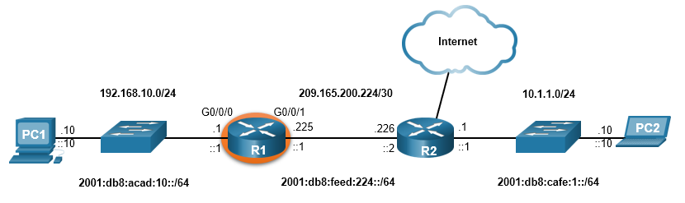
Configure Interfaces
Configure Router Interfaces Example
The commands to configure interface G0/0/0 on R1 are shown here:
R1(config)# interface gigabitEthernet 0/0/0
R1(config-if)# description Link to LAN
R1(config-if)# ip address 192.168.10.1 255.255.255.0
R1(config-if)# ipv6 address 2001:db8:acad:10::1/64
R1(config-if)# ipv6 address fe80::1 link-local
R1(config-if)# no shutdown
R1(config-if)# exit
R1(config)#
*Aug 1 01:43:53.435: %LINK-3-UPDOWN: Interface GigabitEthernet0/0/0, changed state to down
*Aug 1 01:43:56.447: %LINK-3-UPDOWN: Interface GigabitEthernet0/0/0, changed state to up
*Aug 1 01:43:57.447: %LINEPROTO-5-UPDOWN: Line protocol on Interface GigabitEthernet0/0/0, changed state to up
Router(config)# ipv6 unicast-routing – ak chcete IPv6 smerovať medzi rozhraniami
Notes:
10 – Basic Router Configuration
10.2 – Configure Interfaces
10.2.2 – Configure Router Interfaces Example

Slide 50
Configure Interfaces
Configure Router Interfaces Example (Cont.)
The commands to configure interface G0/0/1 on R1 are shown here:
R1(config)# interface gigabitEthernet 0/0/1
R1(config-if)# description Link to R2
R1(config-if)# ip address 209.165.200.225 255.255.255.252
R1(config-if)# ipv6 address 2001:db8:feed:224::1/64
R1(config-if)# ipv6 address fe80::1 link-local
R1(config-if)# no shutdown
R1(config-if)# exit
R1(config)#
*Aug 1 01:46:29.170: %LINK-3-UPDOWN: Interface GigabitEthernet0/0/1, changed state to down
*Aug 1 01:46:32.171: %LINK-3-UPDOWN: Interface GigabitEthernet0/0/1, changed state to up
*Aug 1 01:46:33.171: %LINEPROTO-5-UPDOWN: Line protocol on Interface GigabitEthernet0/0/1, changed state to up
Notes:
10 – Basic Router Configuration
10.2 – Configure Interfaces
10.2.2 – Configure Router Interfaces Example (Cont.)

Slide 51
Configure Interfaces
Verify Interface Configuration
To verify interface configuration use the show ip interface brief and show ipv6 interface brief commands shown here:
R1# show ip interface brief
Interface IP-Address OK? Method Status Protocol
GigabitEthernet0/0/0 192.168.10.1 YES manual up up
GigabitEthernet0/0/1 209.165.200.225 YES manual up up
Vlan1 unassigned YES unset administratively down down
R1# show ipv6 interface brief
GigabitEthernet0/0/0 [up/up]
FE80::1
2001:DB8:ACAD:10::1
GigabitEthernet0/0/1 [up/up]
FE80::1
2001:DB8:FEED:224::1
Vlan1 [administratively down/down]
unassigned
R1#
Notes:
10 – Basic Router Configuration
10.2 – Configure Interfaces
10.2.3 – Verify Interface Configuration

Slide 52
Configure Interfaces
Configure Verification Commands
The table summarizes show commands used to verify interface configuration.
Commands | Description
show ip interface brief show ipv6 interface brief | Displays all interfaces, their IP addresses, and their current status.
show ip route show ipv6 route | Displays the contents of the IP routing tables stored in RAM.
show interfaces | Displays statistics for all interfaces on the device. Only displays the IPv4 addressing information.
show ip interfaces | Displays the IPv4 statistics for all interfaces on a router.
show ipv6 interfaces | Displays the IPv6 statistics for all interfaces on a router.
Notes:
10 – Basic Router Configuration
10.2 – Configure Interfaces
10.2.4 – Configuration Verification Commands

Slide 53
Configure Interfaces
Configure Verification Commands (Cont.)
Display the contents of the IP routing tables with the show ip route and show ipv6 route commands as shown here:
R1# show ip route
< output omitted>
Gateway of last resort is not set
192.168.10.0/24 is variably subnetted, 2 subnets, 2 masks
C 192.168.10.0/24 is directly connected, GigabitEthernet0/0/0
L 192.168.10.1/32 is directly connected, GigabitEthernet0/0/0
209.165.200.0/24 is variably subnetted, 2 subnets, 2 masks
C 209.165.200.224/30 is directly connected, GigabitEthernet0/0/1
L 209.165.200.225/32 is directly connected, GigabitEthernet0/0/1
R1#
R1# show ipv6 route
<output omitted>
C 2001:DB8:ACAD:10::/64 [0/0]
via GigabitEthernet0/0/0, directly connected
L 2001:DB8:ACAD:10::1/128 [0/0]
via GigabitEthernet0/0/0, receive
C 2001:DB8:FEED:224::/64 [0/0]
via GigabitEthernet0/0/1, directly connected
L 2001:DB8:FEED:224::1/128 [0/0]
via GigabitEthernet0/0/1, receive
L FF00::/8 [0/0]
via Null0, receive
R1#
Notes:
10 – Basic Router Configuration
10.2 – Configure Interfaces
10.2.4 – Configuration Verification Commands (Cont.)

Slide 54
Configure Interfaces
Configure Verification Commands (Cont.)
Display statistics for all interfaces with the show interfaces command, as shown here:
R1# show interfaces gig0/0/0
GigabitEthernet0/0/0 is up, line protocol is up
Hardware is ISR4321-2x1GE, address is a0e0.af0d.e140 (bia a0e0.af0d.e140)
Description: Link to LAN
Internet address is 192.168.10.1/24
MTU 1500 bytes, BW 100000 Kbit/sec, DLY 100 usec,
reliability 255/255, txload 1/255, rxload 1/255
Encapsulation ARPA, loopback not set
Keepalive not supported
Full Duplex, 100Mbps, link type is auto, media type is RJ45
output flow-control is off, input flow-control is off
ARP type: ARPA, ARP Timeout 04:00:00
Last input 00:00:01, output 00:00:35, output hang never
Last clearing of "show interface" counters never
Input queue: 0/375/0/0 (size/max/drops/flushes); Total output drops: 0
Queueing strategy: fifo
Output queue: 0/40 (size/max)
5 minute input rate 0 bits/sec, 0 packets/sec
5 minute output rate 0 bits/sec, 0 packets/sec
1180 packets input, 109486 bytes, 0 no buffer
Received 84 broadcasts (0 IP multicasts)
0 runts, 0 giants, 0 throttles
<output omitted>
R1#
Notes:
10 – Basic Router Configuration
10.2 – Configure Interfaces
10.2.4 – Configuration Verification Commands (Cont.)

Slide 55
Configure Interfaces
Configure Verification Commands (Cont.)
Display IPv4 statistics for router interfaces with the show ip interface command, as shown here:
R1# show ip interface g0/0/0
GigabitEthernet0/0/0 is up, line protocol is up
Internet address is 192.168.10.1/24
Broadcast address is 255.255.255.255
Address determined by setup command
MTU is 1500 bytes
Helper address is not set
Directed broadcast forwarding is disabled
Outgoing Common access list is not set
Outgoing access list is not set
Inbound Common access list is not set
Inbound access list is not set
Proxy ARP is enabled
Local Proxy ARP is disabled
Security level is default
Split horizon is enabled
ICMP redirects are always sent
ICMP unreachables are always sent
ICMP mask replies are never sent
IP fast switching is enabled
IP Flow switching is disabled
<output omitted>
R1#
Notes:
10 – Basic Router Configuration
10.2 – Configure Interfaces
10.2.4 – Configuration Verification Commands (Cont.)

Slide 56
Configure Interfaces
Configure Verification Commands (Cont.)
Display IPv6 statistics for router interfaces with the show ipv6 interface command shown here:
R1# show ipv6 interface g0/0/0
GigabitEthernet0/0/0 is up, line protocol is up
IPv6 is enabled, link-local address is FE80::1
No Virtual link-local address(es):
Description: Link to LAN
Global unicast address(es):
2001:DB8:ACAD:10::1, subnet is 2001:DB8:ACAD:10::/64
Joined group address(es):
FF02::1
FF02::1:FF00:1
FF02::1:FF44:49B0
MTU is 1500 bytes
ICMP error messages limited to one every 100 milliseconds
ICMP redirects are enabled
ICMP unreachables are sent
ND DAD is enabled, number of DAD attempts: 1
ND reachable time is 30000 milliseconds (using 30000)
ND NS retransmit interval is 1000 milliseconds
R1#
Notes:
10 – Basic Router Configuration
10.2 – Configure Interfaces
10.2.4 – Configuration Verification Commands (Cont.)
10.2.5 Syntax Checker – Configure Interfaces

Slide 57
10.3 Configure the Default Gateway
Notes:
10 – Basic Router Configuration
10.3 Configure the Default Gateway

Slide 58
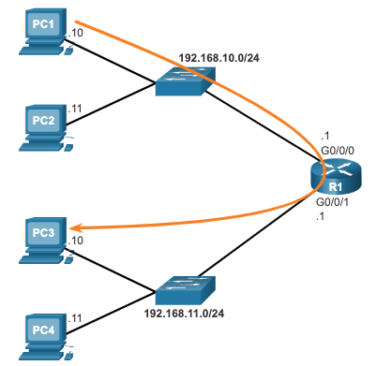
Configure the Default Gateway
Default Gateway on a Host
The default gateway is used when a host sends a packet to a device on another network.
The default gateway address is generally the router interface address attached to the local network of the host.
To reach PC3, PC1 addresses a packet with the IPv4 address of PC3, but forwards the packet to its default gateway, the G0/0/0 interface of R1.
Note: The IP address of the host and the router interface must be in the same network.
Notes:
10 – Basic Router Configuration
10.3 – Configure the Default Gateway
10.3.1 – Default Gateway on a Host

Slide 59
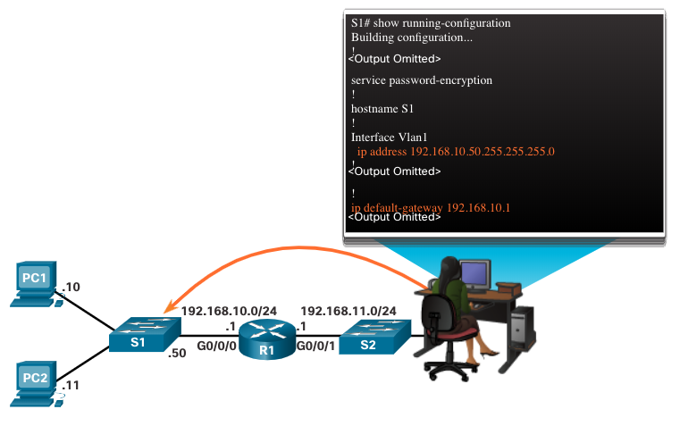
Configure the Default Gateway
Default Gateway on a Switch
A switch must have a default gateway address configured to remotely manage the switch from another network.
To configure an IPv4 default gateway on a switch, use the ip default-gateway ip-address global configuration command.
Notes:
10 – Basic Router Configuration
10.3 – Configure the Default Gateway
10.3.2 – Default Gateway on a Switch
10.3.3 – Syntax Checker – Configure the Default Gateway

Slide 60
Configure the Default Gateway
Default Gateway on a Router
A router may have a default gateway address configured
To configure an IPv4 default gateway on a router, use the global configuration command
ip route 0.0.0.0 0.0.0.0 serial 0/0/0
To configure an IPv6 default gateway on a router, use the global configuration command
ipv6 route ::/0 serial 0/0/0
Notes:
10 – Basic Router Configuration
10.3 – Configure the Default Gateway
10.3.2 – Default Gateway on a Switch
10.3.3 – Syntax Checker – Configure the Default Gateway

